Slide 1
MOVIE RESERVATION SYSTEM USING C LANGUAGE
TEAM MEMBERS
RESSHMI B C (CSB2131)
UMAVANI K(CSB2154)
PRAKALYA R S(CSB2117)
S.K.PRIYADHARSHINI(CSB2126)

Slide 2

CODE LINK: https://onlinegdb.com/uvqGOp0O8

Slide 3
ABSTRACT
Simple Movie Ticket Booking System is based on a concept of recording and booking customer’s movie ticket details.
Here the user can perform all the tasks like booking a movie show, receiving tickets, and card registration and view all movie show details.
Talking about the features of the Simple Movie Ticket Booking System, a user can select any movie provided in the list.
After selecting a show, he/she has to select timings, then the system asks for personal information which include Name, contact number.
After that, the system automatically displays the final outcome which is the user’s bill.

Slide 4
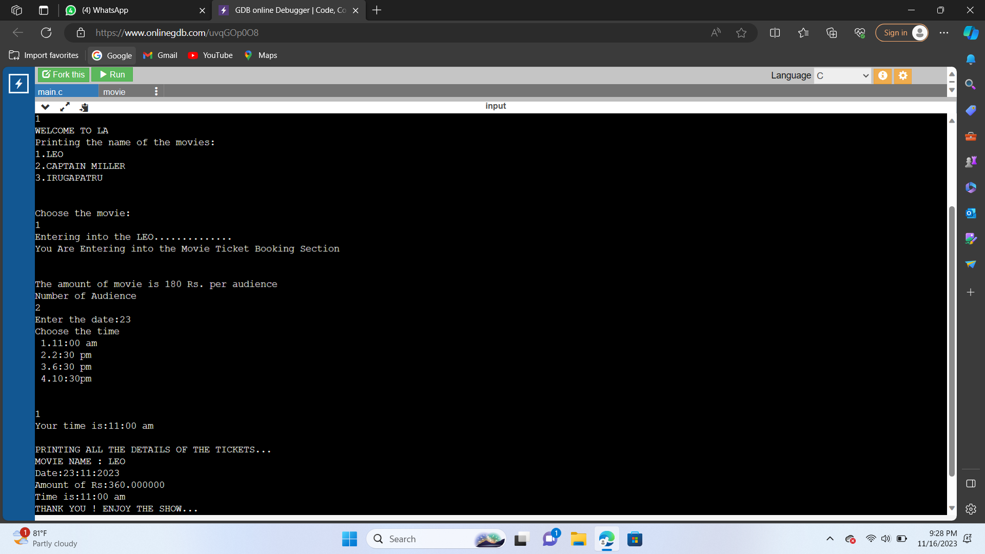
OUTPUT SCREENSHOT:

Slide 5


